Slide 1

By Albina Frolova

Slide 2
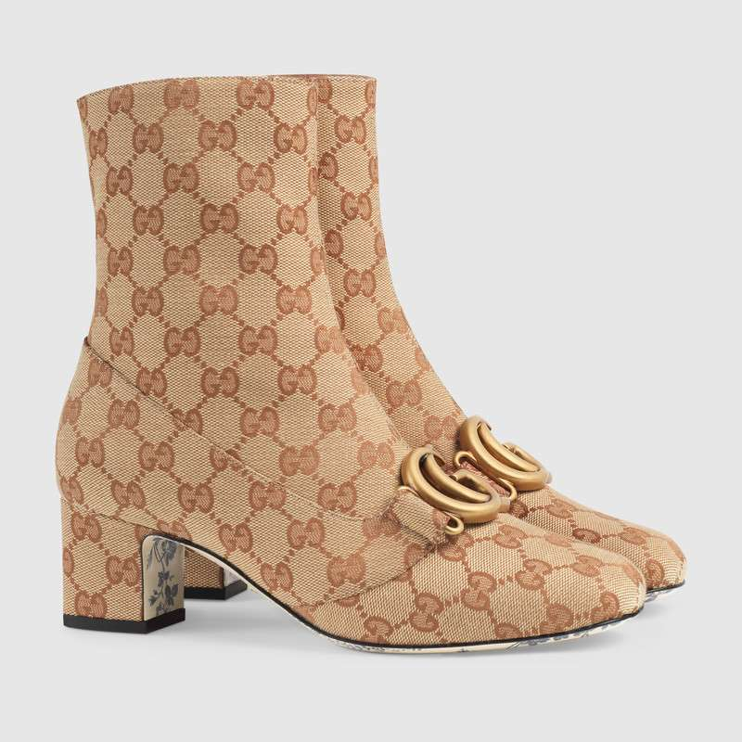
Selling your idea
A web page that will sell a variety of shoes made by famous designers.
Market will be focused mostly on shoes for women.
Enormous expansion of fashion industry not only in big cities such as New York, Paris, and Milan, but also in small cities like Houston where I came from.
A variety of a payment options.

Slide 3


Business Problems
Time Saving No more lines and traffic stresses.
Weather Conditions & Holidays No more cancelling your shopping days due to unpredictable conditions..
Store’s Lack of Assortiment Get the best deals you can.

Slide 4
Success Criteria.
Great future scope.
Online shopping is easy to maintain, ready to run, scalable, affordable, and reliable cost saving tool suited for small, medium, and large shopping complex and shopping malls.
The proposed system can be used even by naive users, and it won’t require any educational level, experience, and technical expertise in computer field.
It’s going to be of good use if the user has the good knowledge of how to operate a computer.
FYI
User-friendly software for online shopping.
Website has all the facilities for the customers starting from price enquiries, offers, availability of stock, quality, store details, contacts and ordering the goods.

Slide 5
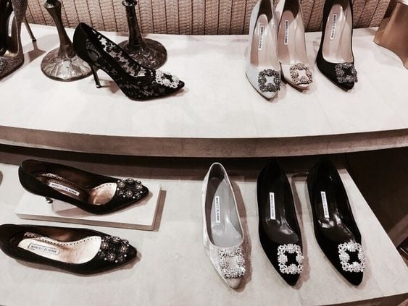
Thank you!

